Slide 1


TITLE
Web scraping of reviews to gain insights
By : Dinesh Rawat
Date : 6/24/2023
Forage British Airways Virtual Internship program

Slide 2
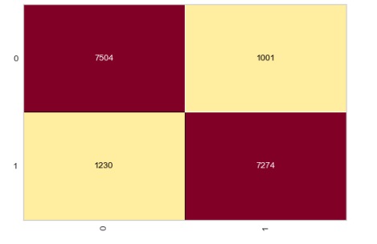
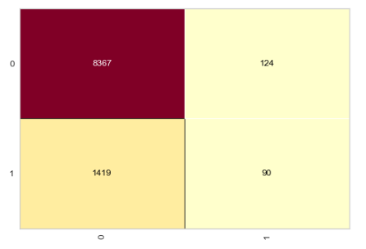
evaluate of Predicive model
ML Algorithm used : Random forest classifier
Here's how the Random Forest algorithm works for classification problems:
The algorithm selects a random subset of the features from the training data.
The algorithm constructs a decision tree based on the selected features and their split points.
The algorithm repeats the above two steps multiple times to create a collection of decision trees.
When predicting a new data point, each tree in the collection outputs a predicted class, and the class that appears most frequently across all the trees is chosen as the final prediction.
Evaluation score for our 2 types of model
Imbalance Accuracy : 0.851 Precision : 0.526 Recall : 0.108 F1 score : 0.179 RMSE : 0.386
Balance Accuracy : 0.882 Precision : 0.868 Recall : 0.900 F1 score : 0.883 RMSE :0.344

Slide 3
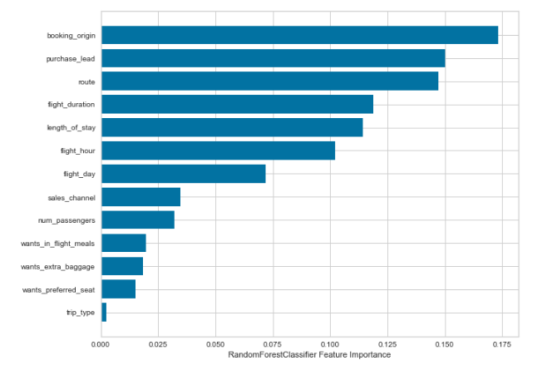
variable contributed to the Predicive model

